Slide 1
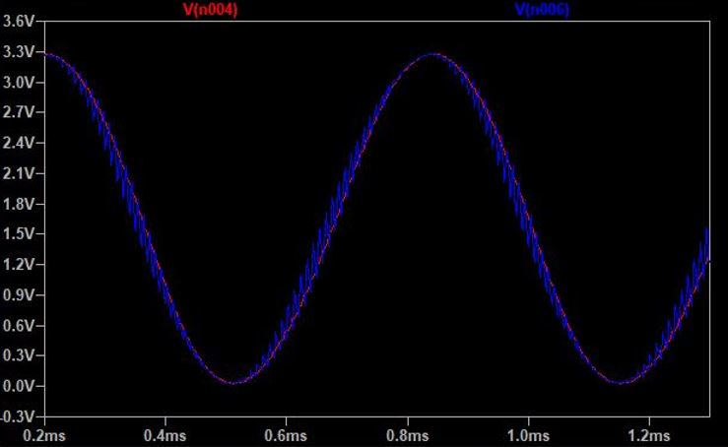

Analog synthesis of a Sine wave using a pure digital FPGA chip
Giulia Gioachin
Flavio Galaverna

Slide 2
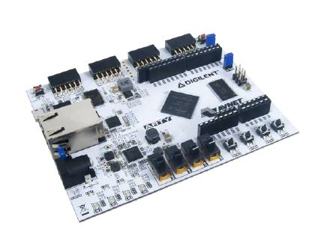

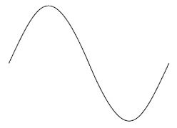
About the Project

Slide 3

General Scheme
PWM
ANALOG INTERFACE
EN
1
3
V_{out}
PLL
ROM
BINARY COMPARATOR
COUNTER
DAC
PULSE GENERATOR
SHIFT REGISTER
INTERFACE LOGIC
4
V_{out}
CLK
2

Slide 4
First Mode PWM Technique
EN
1
PLL
ROM
BINARY COMPARATOR
COUNTER
PWM
ANALOG INTERFACE
3
V_{out}
PULSE GENERATOR
CLK
2

Slide 5
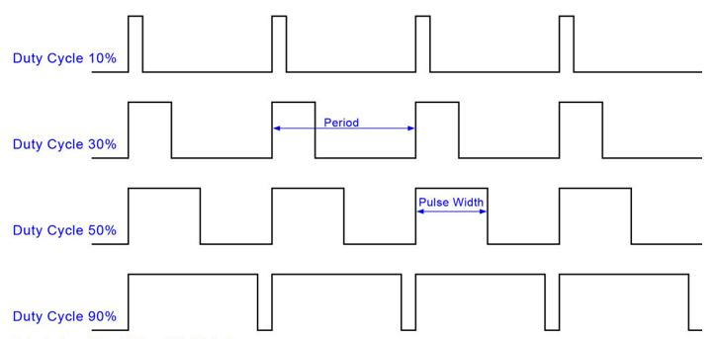
Pulse Width Modulation
The PWM (Pulse Width Modulation) technique allows to program the duty cycle of a periodic signal

Slide 6

Pulse Width Modulation
The PWM (Pulse Width Modulation) technique allows to program the duty cycle of a periodic signal
How does PWM generate a Sine Wave?

Slide 7
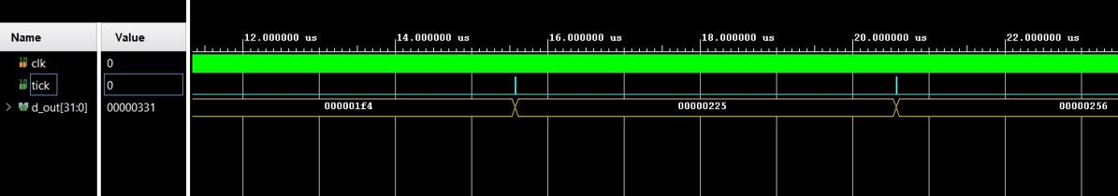
Read Only Memory (ROM)
ROM (Read Only Memory):
(32x64) bits
64 hexadecimal values belonging to a sine wave with amplitude between 0 and 1000
Allocated in a B-RAM in FPGA
A 32-bit counter generates an output (Tick) every 1000 clock posedge.
If Tick is equal to 1 the memory read one data
Clock 200 MHz
Tick
ROM data

Slide 8
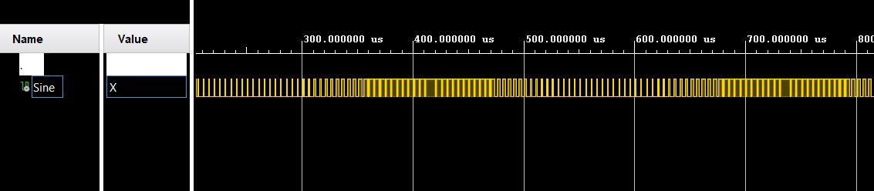
Sine wave with PWM
A Binary Comparator (the heart of the PWM block) compares the ROM data values with a 32-bit counter:
ROM data > counter → 1
Counter > ROM data → 0
In this way the duty cycle changes and the time in which the signal is 1 increases with the increase of the sine value.
Sine

Slide 9
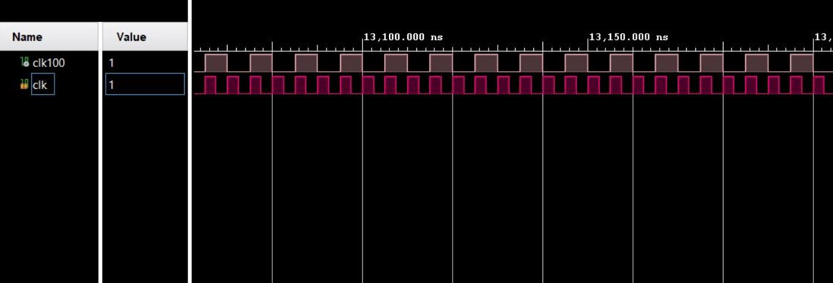
IP Blocks
PLL → Phase Locked Loop to provide a 200 MHz clock as input
IP-ROM → a ROM with the same size to the previous one to replace it
Clock 100 MHz
Clock 200 MHz

Slide 10
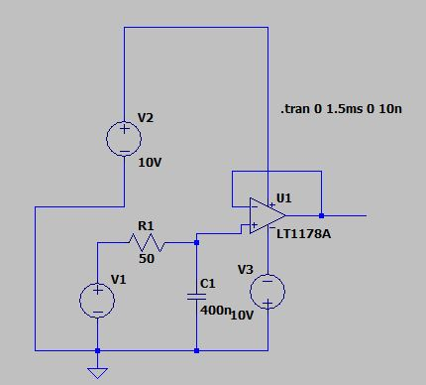
Displaying the Sine Wave using LTspice
To visualize the Sine output as an analog output it is possible to use a simulator → LTspice
Built a circuit as
A voltage generator (V4) able to read a file with the time (on sec) and the sine values after the PWM technique ( the digital sine values are multiplied by 3.3V)
A resistance of 50 Ohm
A capacity of 400 nF
An operational amplifier (LT1178A)

Slide 11
Displaying the Sine Wave using LTspice
Blue line is the output from the RC circuit
Red line is the output from the OP-AMP

Slide 12
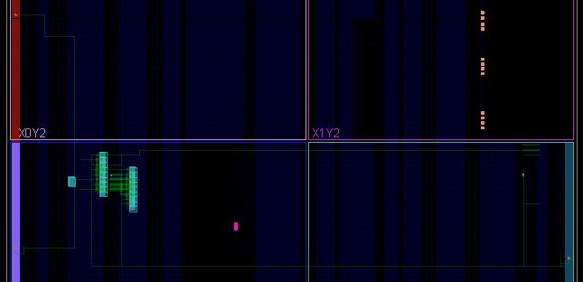
Project implementation on FPGA
Some constraints are used:
Position for the input ports (En and Clk100) and output port (Sine)
An input clock of 100 MHz, with a duty cycle of 50%
A capacity of 20 pF at the output
A 10 ns delay to all input ports
B-RAM

Slide 13
Second Mode DAC
dac_enable
PLL
PULSE GENERATOR
ROM
TRASMITTER SIMULATION
TRANSMISSION INTERFACE
DAC
1
3
V_{out}
CLK
2

Slide 14
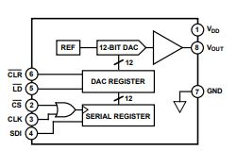
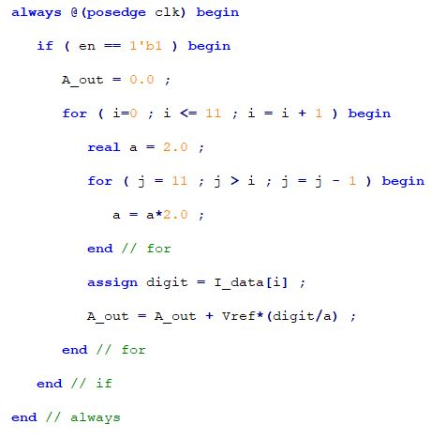
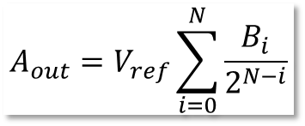
Digital to Analog Converter (DAC)
$$A_{out}=V_{ref}\sum_{i=0}^{N}{\frac{B_{i}}{2^{N−i}}}$$
CLR: set all the data on the DAC REGISTER to 0 (not used in the project)
LD: enables data recording on the DAC REGISTER
CS: enables data shifting on the SERIAL REGISTER
CLK: allows synchronus transmission
SDI: serial data input

Slide 15
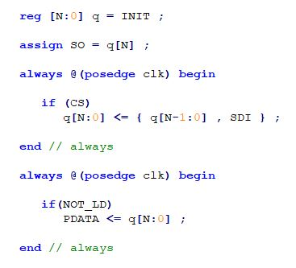
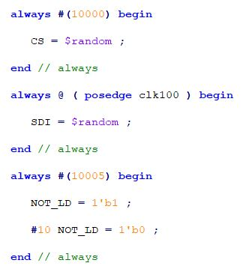
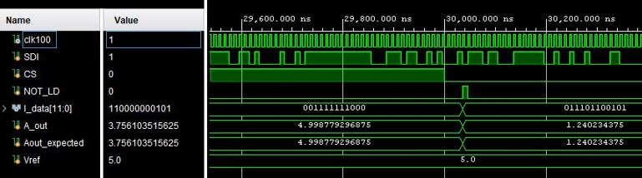
The DAC serial interface implementation
SIPO 12 BIT SHIFT REGISTER
NOT SYNTHESIZEBLE ON THE FPGA CHIP
CS
12 BIT SHIFT REGISTER
12
1
I_data
SDI
4
2
LD
3
SYSTEM VERILOG CODE
CLK
4
The DAC BEHAVIOURAL simulation

Slide 16
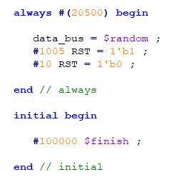
The FPGA set up
SYNTHESIZEBLE ON THE FPGA CHIP
IMPLEMENTED MODULE
TARGET
SIMULATION OF A REAL TRANSMITTER
TRANSMITTER SIMULATION
NEED TO TRANSMIT THE DATA CORRECTLY
TRANSMISSION INTERFACE
VERILOG CODE
Transmitter simulation
Data_bus
1
COUNTER
4
SO
32
RST
2
1 BYTE SHIFT REGISTER
CLK
3
5
LD_pdata

Slide 17
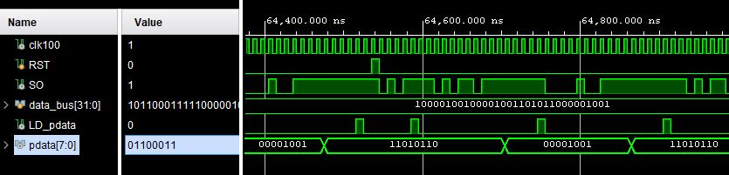
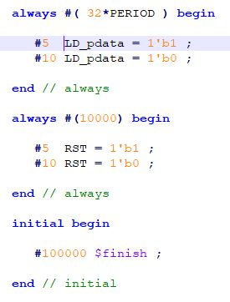
TRANSMISSION INTERFACE
BEHAVIOURAL SIMULATION OF THE TRASNMITER SIMULATION MODULE
LD_pdata
1
COUNTER
4
CS
TEST BENCH CODE FOR THE TRASMISSION INTERFACE MODULE
RST
2
1 BYTE SHIFT REGISTER
5
LD
CLK
3

Slide 18
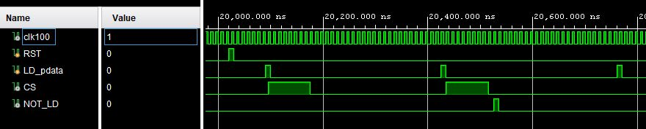
BEHAVIOURAL SIMULATION OF THE TRASMISSION INTERFACE MODULE

Slide 19
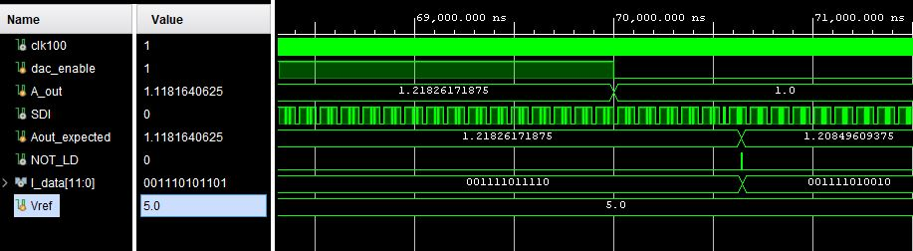
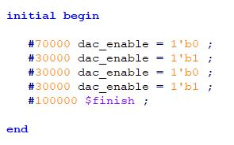
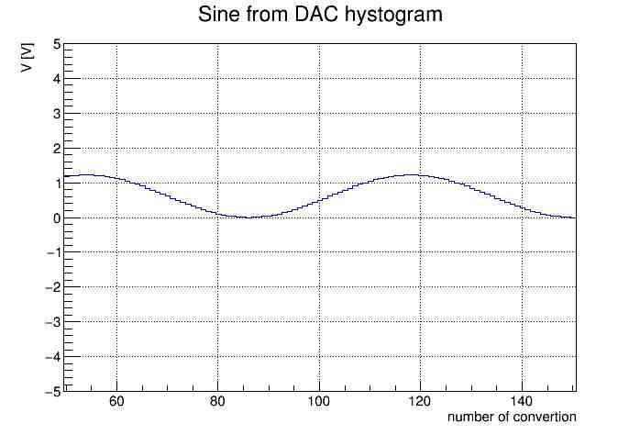
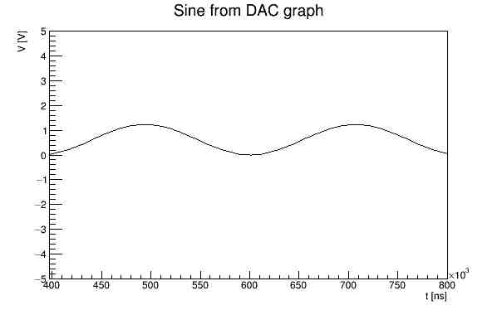
TEST BENCH CODE FOR THE TOP LEVEL MODULE
BEHAVIOURAL SIMULATION OF THE TOP LEVEL MODULE
USING VERILOG TASKS AND A PYTHON SCRIPT IS POSSIBLE TO WRITE THE DATA IN A ASCII FILE AND PLOT THEM

Slide 20



